Slide 1
Astable CMOS CIRCUITS
Tatu Bogdan

Slide 2


Astable circuits
1
SEQUENTIAL CIRCUITS
NO STABLE STATE
RANDOM NUMBER GENERATORS
PERIODIC SIGNAL GENERATORS
CLOCK SIGNAL
T0
T1
0

Slide 3
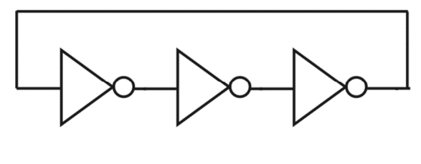
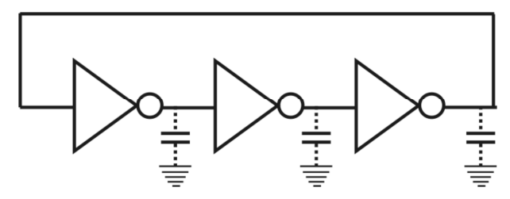
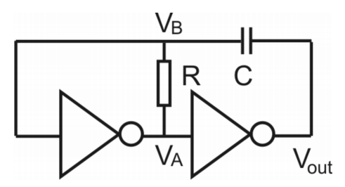
asTABLE CIRCUITS
RING OSCILATOR
RC OSCILATOR

Slide 4
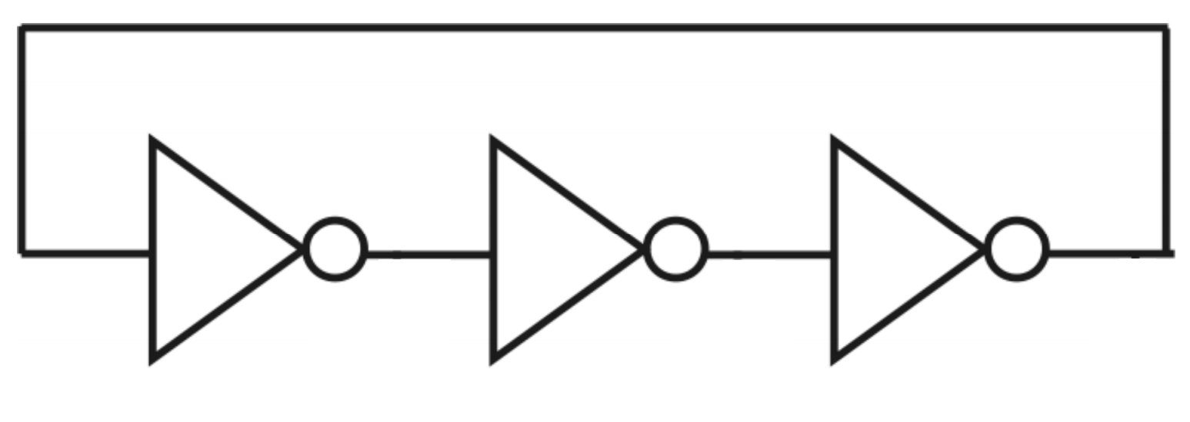
RING OSCILATOR
⬈1
⬈1
⬈1
⬊0
⬊0
⬊0
0
td
td
td
5
4
6
1
2
3
0
* td

Slide 5
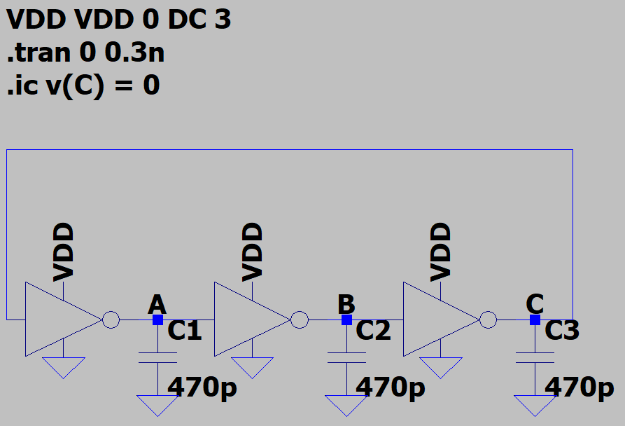
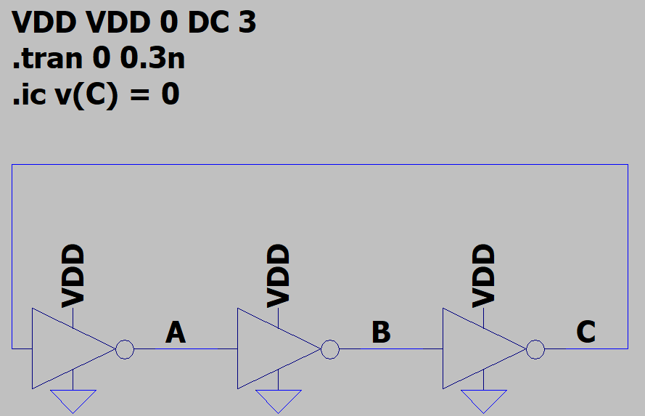
RING OSCILATOR – SPICE model

Slide 6
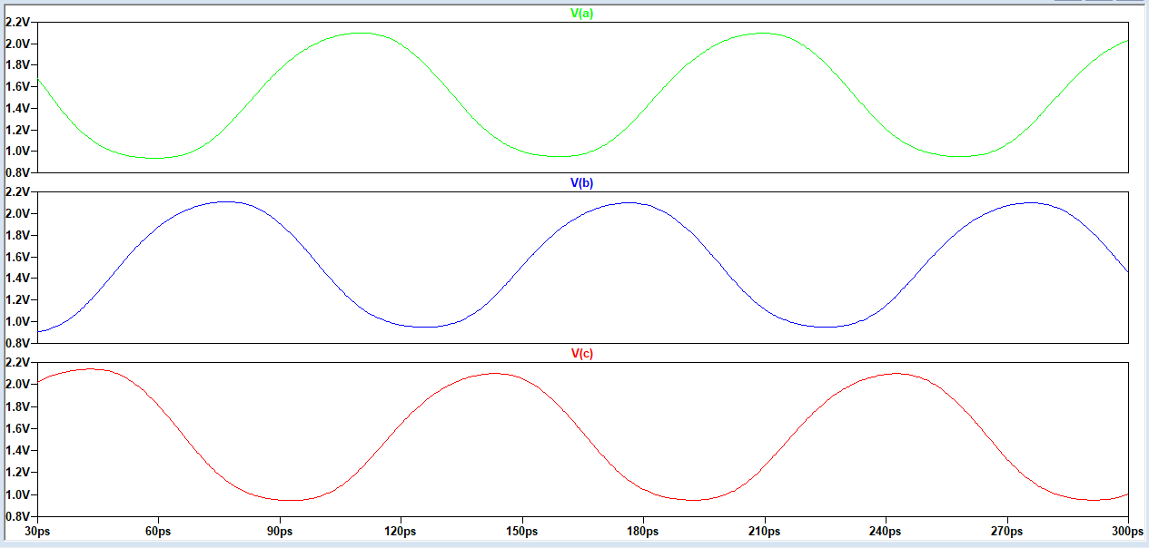
Ring oscillator – spice simulation
A | B | C
0 | 1 | ⬊0
⬈1 | 1 | 0
1 | ⬊0 | 0
1 | 0 | ⬈1
⬊0 | 0 | 1
0 | ⬈1 | 1
0 | 1 | ⬊0

Slide 7
Ring oscillator – spice simulation
A | B | C
0 | 1 | ⬊0
⬈1 | 1 | 0
1 | ⬊0 | 0
1 | 0 | ⬈1
⬊0 | 0 | 1
0 | ⬈1 | 1
0 | 1 | ⬊0

Slide 8
Ring oscillator – spice simulation
A | B | C
0 | 1 | ⬊0
⬈1 | 1 | 0
1 | ⬊0 | 0
1 | 0 | ⬈1
⬊0 | 0 | 1
0 | ⬈1 | 1
0 | 1 | ⬊0

Slide 9
Ring oscillator – spice simulation
A | B | C
0 | 1 | ⬊0
⬈1 | 1 | 0
1 | ⬊0 | 0
1 | 0 | ⬈1
⬊0 | 0 | 1
0 | ⬈1 | 1
0 | 1 | ⬊0

Slide 10
Ring oscillator – spice simulation
A | B | C
0 | 1 | ⬊0
⬈1 | 1 | 0
1 | ⬊0 | 0
1 | 0 | ⬈1
⬊0 | 0 | 1
0 | ⬈1 | 1
0 | 1 | ⬊0

Slide 11
Ring oscillator – spice simulation
A | B | C
0 | 1 | ⬊0
⬈1 | 1 | 0
1 | ⬊0 | 0
1 | 0 | ⬈1
⬊0 | 0 | 1
0 | ⬈1 | 1
0 | 1 | ⬊0

Slide 12
Ring oscillator – spice simulation
A | B | C
0 | 1 | ⬊0
⬈1 | 1 | 0
1 | ⬊0 | 0
1 | 0 | ⬈1
⬊0 | 0 | 1
0 | ⬈1 | 1
0 | 1 | ⬊0

Slide 13
Ring oscillator – spice simulation
A | B | C
0 | 1 | ⬊0
⬈1 | 1 | 0
1 | ⬊0 | 0
1 | 0 | ⬈1
⬊0 | 0 | 1
0 | ⬈1 | 1
0 | 1 | ⬊0

Slide 14
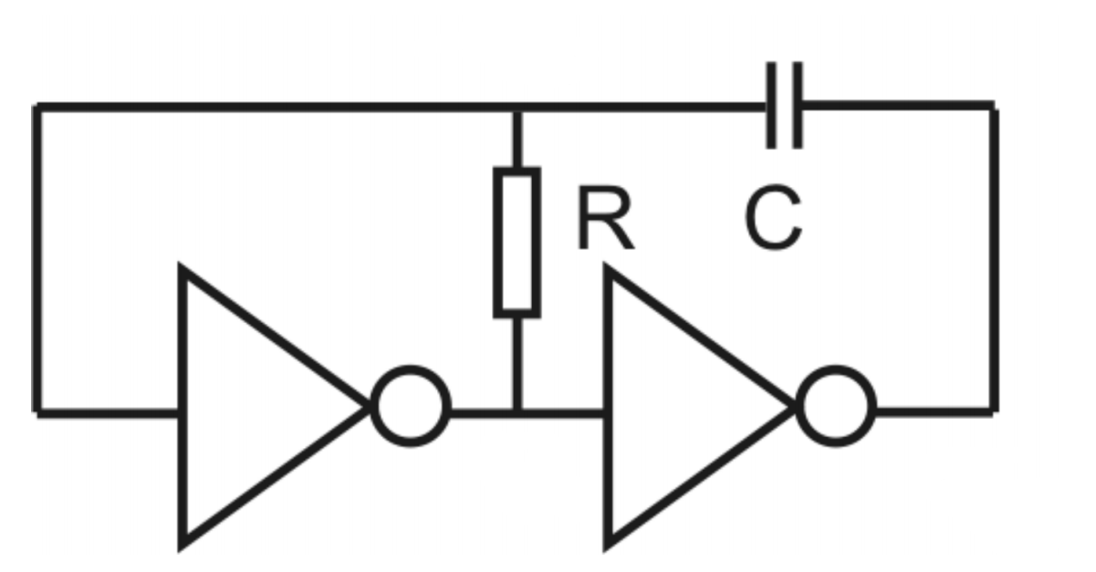
RC OSCILATOR
max
⬈
⬈
neg
⬊
sw
⬊
1
0
0
1
1

Slide 15
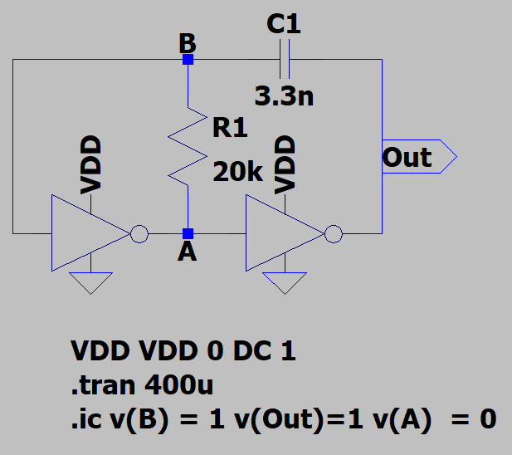
RC OSCILATOR – SPICE MODEL

Slide 16
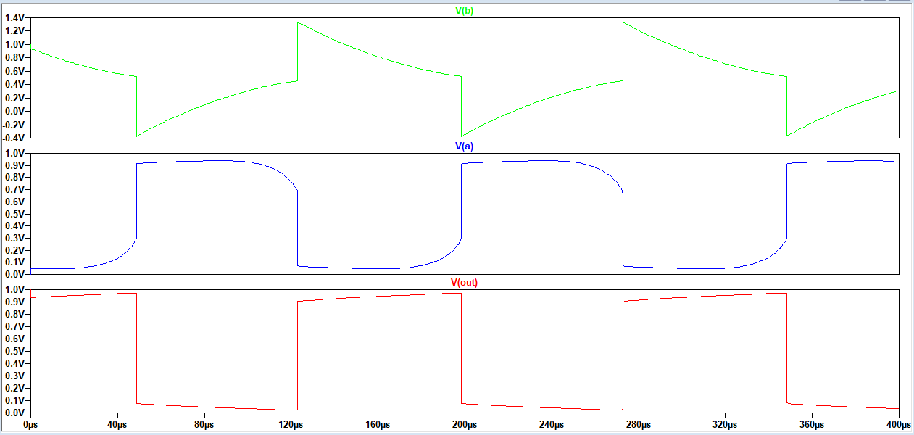
RC OSCILATOR – SPICE SIMULATION
B | A | Out
1 | 0 | 1
⬊ | 0 | 1
sw | 1 | 0
neg | 1 | 0
⬈ | 1 | 0
sw | 0 | 1
1 | 0 | 1

Slide 17
RC OSCILATOR – SPICE SIMULATION
B | A | Out
1 | 0 | 1
⬊ | 0 | 1
sw | 1 | 0
neg | 1 | 0
⬈ | 1 | 0
sw | 0 | 1
1 | 0 | 1

Slide 18
RC OSCILATOR – SPICE SIMULATION
B | A | Out
1 | 0 | 1
⬊ | 0 | 1
sw | 1 | 0
neg | 1 | 0
⬈ | 1 | 0
sw | 0 | 1
1 | 0 | 1

Slide 19
RC OSCILATOR – SPICE SIMULATION
B | A | Out
1 | 0 | 1
⬊ | 0 | 1
sw | 1 | 0
neg | 1 | 0
⬈ | 1 | 0
sw | 0 | 1
1 | 0 | 1

Slide 20
RC OSCILATOR – SPICE SIMULATION
B | A | Out
1 | 0 | 1
⬊ | 0 | 1
sw | 1 | 0
neg | 1 | 0
⬈ | 1 | 0
sw | 0 | 1
1 | 0 | 1

Slide 21
RC OSCILATOR – SPICE SIMULATION
B | A | Out
1 | 0 | 1
⬊ | 0 | 1
sw | 1 | 0
neg | 1 | 0
⬈ | 1 | 0
sw | 0 | 1
1 | 0 | 1

Slide 22
RC OSCILATOR – SPICE SIMULATION
B | A | Out
1 | 0 | 1
⬊ | 0 | 1
sw | 1 | 0
neg | 1 | 0
⬈ | 1 | 0
sw | 0 | 1
1 | 0 | 1

Slide 23
RC OSCILATOR – SPICE SIMULATION
B | A | Out
1 | 0 | 1
⬊ | 0 | 1
sw | 1 | 0
neg | 1 | 0
⬈ | 1 | 0
sw | 0 | 1
1 | 0 | 1

